Slide 1
Asheville Urban Trail
A self guided tour through Downtown Asheville

Slide 2
Introduction
The Asheville Urban Trail is a history and art museum without walls, it’s a walk through time, an opportunity to examine buildings, study neighborhoods, and learn about people and events that have given Asheville a distinctive history. The application will provide users a walking tour of several downtown locations. They will be able to see an image, read about or listen to a pre-recorded audio message about the Urban Trail locations.

Slide 3
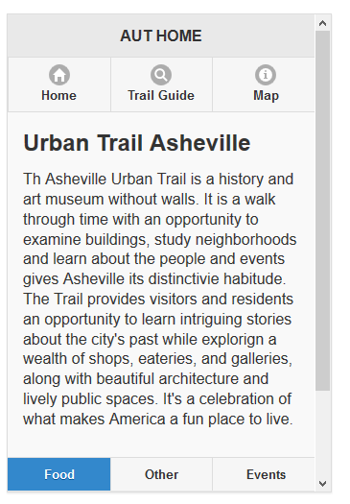
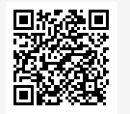
The HOME page will give a brief description about the Urban Trail and will display the navigation menu for the “Trail Guide” and the “Map” pages.
A footer navigation menu could be used for other purposes. As of now it’s a placeholder.

Slide 4
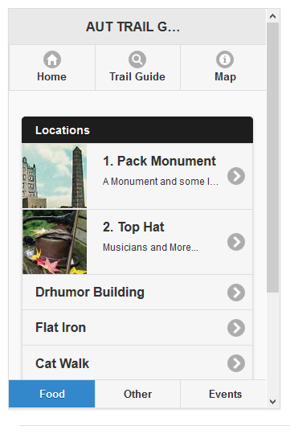
The “Trail Guide” page will provide a list of the locations and link to a page that provides the audio, text and an image of the location.

Slide 5
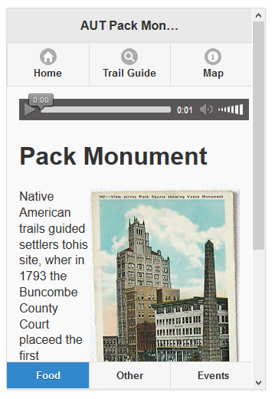
Once the user clicks on one of the locations the app will display a audio bar, a title of the location, an image and the text describing the location.

Slide 6
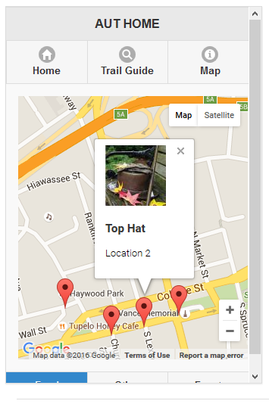
The handy map will show the locations of the trail.

Slide 8
Pages and Dialogs
A page in jQuery Mobile consists of an element with a “data-role-”page”” attribute. Within the “page” container, any valid HTML markup can be used, but for typical pages in jQuery Mobile, the immediate children of a “page” are divs with “data-role=“header”, class=“ui-content”” and “data-role=“footer”. The baseline requirement for a page is only the page “wrapper” to support the navigation system.

Slide 9
Ajax Navigation and Transitions
jQuery Mobile includes an Ajax navigation system to support a rich set of animated page transitions by automatically “hijacking” standard links and form submissions and turning them into an Ajax request.
Whenever a link is clicked or a form is submitted, that event is automatically intercepted by the Ajax nav system and is used to issue an Ajax request based on the href or form action instead of reloading the page. While the framework waits for the Ajax response, the loader overlay is displayed.

Slide 10
Ajax Navigation and Transitions
When the requested page loads, jQuery Mobile parses the document for an element with the “data-role=“page”” attribute and inserts that code into the DOM of the original page. Next, any widgets in the incoming page are enhanced to apply all the styles and behavior. The rest of the incoming page is discarded so any scripts, stylesheets or other information will not be included. The framework will also note the title of the incoming to update the title when the new page is transitioned into view. Now that the requested page is in the DOM and enhanced, it is animated into view with a transition.

